Slide 1
Gender Pay Gap Report 2023 doing good

Slide 2
Introduction
Since legislation was introduced in April 2017 employers with 250 or more employees have been required to publish information each year to show the difference in average hourly pay between their male and female employees. All of the information in this report is based on data from the required “snapshot” date of 5 April 2020.
For more information please see:
https://www.gov.uk/government/news/uk-gender-pay-gap
Whilst both gender pay and equal pay look at the pay received by men and women they focus on two different issues:
Gender pay
Looks at the difference between women’s and men’s average pay across the organisation
Equal Pay
Looks at the pay that men and women receive whilst performing the same role

Slide 3
Gender pay gap
A positive percentage pay gap indicates that men are paid more, whilst a negative percentage pay gap indicates that women are paid more
Employers must report
The difference in the mean (average) pay of men and women, expressed as a percentage;
The difference in the median (actual midpoint) pay of men and women, expressed as a percentage;
The proportion of men and women who received bonus pay; and
The difference in mean and median bonus pay, expressed as a percentage;
The number of men and women in each of four quartile pay bands.

Slide 4
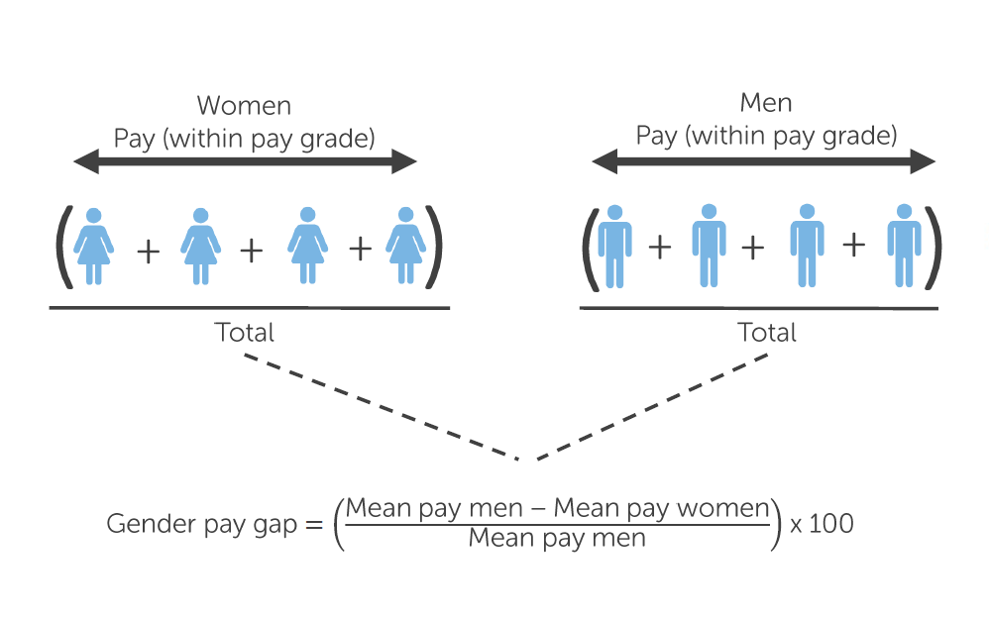
The overall mean gender pay gap is the difference between mean (average) hourly earnings of men and women expressed as a percentage of the mean hourly earnings of men.
Mean gender pay gap calculation

Slide 5
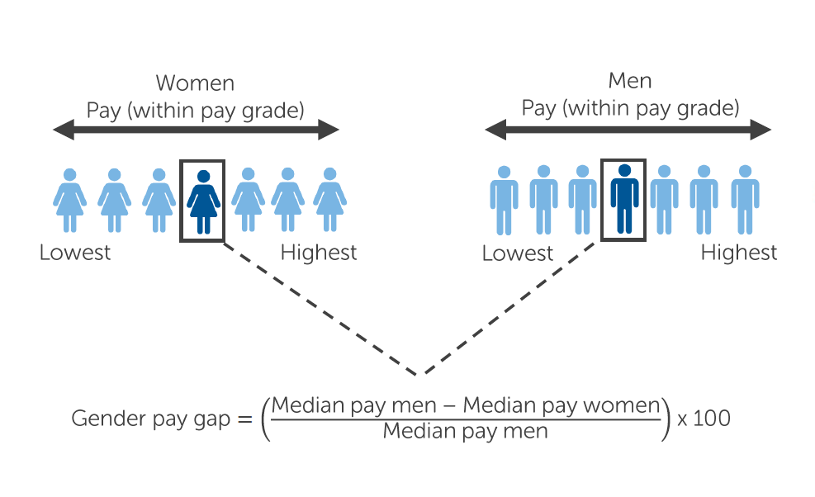
Median gender pay gap calculation
The overall median gender pay gap is the difference between median (actual midpoint) hourly earnings of men and women expressed as a percentage of the median hourly earnings of men.

Slide 6
Workforce by gender
Just over 15% of ODS’s workforce are female with the majority being male
This report is based on salary data at a snapshot date of 5 April 2023.
There were 529 ‘relevant employees’ employed by ODS on the snapshot date. The gender pay gap analysis is based on head count (actual number of employees regardless of hours worked) as opposed to full-time equivalent numbers.

Slide 7
At ODS there are 17 females and 14 males working part-time, this equates to 20.73% of the total female workforce compared to 3.11% of the male workforce
Part-time gender ratio
1 female to 1.25 male
Full-time gender ratio
1 female to 5.59 male
Full-time is defined as 37 hours per week. Anything less than this is considered as part time.

Slide 8
Gender Pay Gap Details for the snapshot of 5 April 2023
Mean Gender Pay Gap (Basic Pay) | -12.81%
Median Gender Pay Gap (Basic Pay) | -0%
Mean Gender *bonus gap | 0
Median Gender *bonus Gap (Basic Pay) | 0
Proportion of Males receiving *bonus | 0
Proportion of Females receiving *bonus | 0
* There were no bonuses paid in this period

Slide 9
Distribution by Quartile
Quartile | Males % | Females %
Top quartile | 80.77 | 19.23
Upper middle quartile | 86.15 | 13.85
Lower middle quartile | 80 | 20
Lower quartile | 93.08 | 6.92
TOTAL | 85 | 15
The four quartiles are separated according to the hourly pay rate, starting from the lowest to the highest paid member of staff.
The advantage of calculating quartiles by dividing the overall pay distribution in to four equal proportions is that we can look at the different ranges of gender pay gap across the salary scale.

Slide 10
We will continue to monitor our gender pay gap in line with government legislation, and review it on an annual basis to ensure that progress is maintained.
We believe our long-term strategy to inspire, attract and nurture a balanced and diverse workforce will help ensure we continue to achieve balance in our pay arrangements.

Slide 11
Our vision is to make your world a better place to live, work and visit. This means that in whatever we do, we want to bring out the best results, we want to be doing good. And what you invest in us gets reinvested in our people and our communities. That's because our profits go back to our sole owner, Oxford City Council, who will reinvest it in services for the community.
For more information on our service please visit our website: https://www.odsgroup.co.uk/ where you can also find a copy of our Annual Report.
I confirm that Oxford Direct Services' gender pay gap calculations are accurate and meet the requirements of the Equality Act 2010 (Gender Pay Gap Information) Regulations 2017.
For and on behalf of the Board of Oxford Direct Services LTD
Simon Howick
Managing Director

